Slide 1
Examples of Raw Data

Slide 2
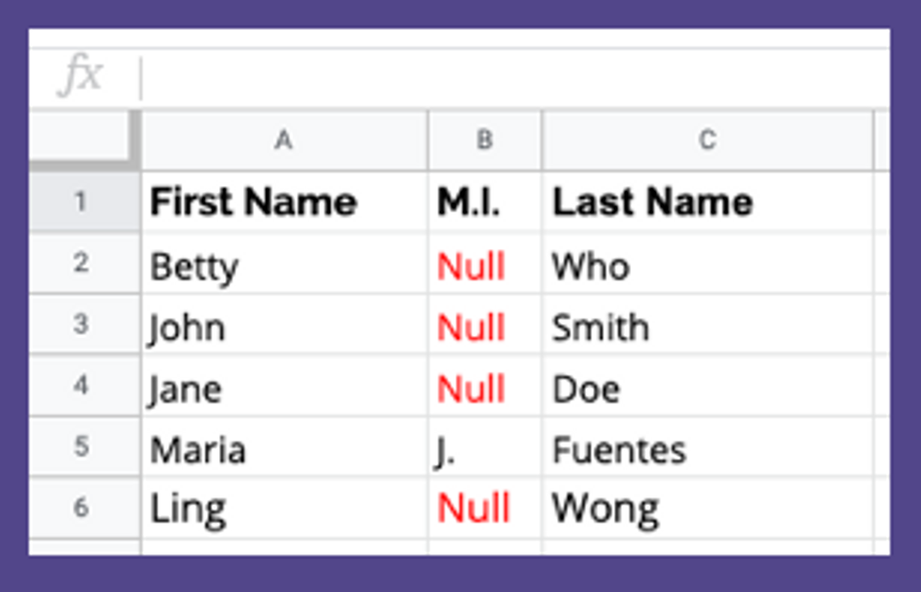
Incomplete Data
Before Cleaning
In this example, there a null values instead of Middle Initials. Null values are placeholders to signify missing or unknown values. Oftentimes, null values can present issues in data analysis and visualizations. Therefore, it is important to have a standardized way of taking care of these values.

Slide 3
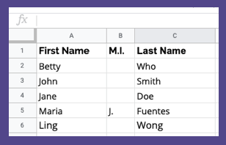
Incomplete Data
After Cleaning
In this case, we decided to replace all null values for blank spaces. Therefore, when the names are processed, it will not include "Null" as the middle initial.

Slide 4
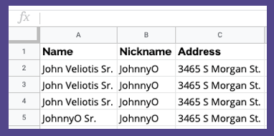
Duplicate Data
Before Cleaning
In this example, it appears that there are four entries for the same person. However, this is an assumption that may not be true. It is possible that there are four JohnnyOs living at 3465 S Morgan St. Therefore, it is important to check your data sources and collection methods before potential deletion.

Slide 5
Duplicate Data
After Cleaning
After determining these were duplicate entries, then we safely deleted extraneous entries. Now, there is only one John Veliotis Sr. at 3465 S Morgan St. in our data.

Slide 6
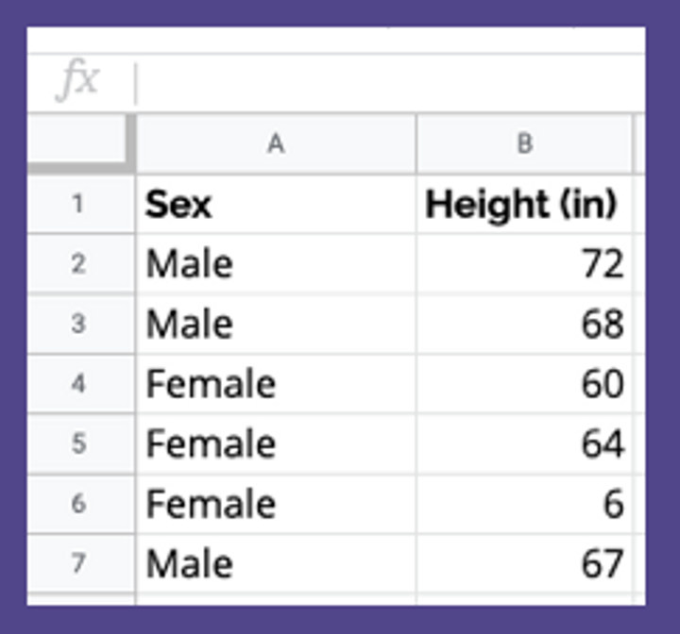
Incorrect Data
Before Cleaning
In this example, we have an extreme outlier. In row 6, a female respondent is listed to be 6 inches tall. We can make a set a standard and assume that this is incorrect. Therefore, we need to determine how to deal with this outlier. Do we remove it? Do we re-survey the participant?

Slide 7
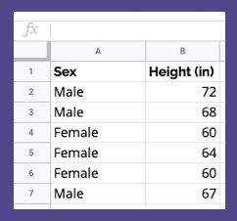
Incorrect Data
After Cleaning
In this case, we had the ability and the resources to verify with the female respondent. We have corrected the data to list 60 inches.

Slide 8
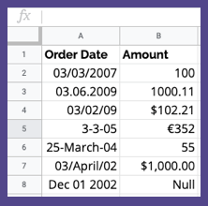
Inconsistent Data
Before Cleaning
All data in this example is inconsistent. The format for both dates and currency are unstandardized. We need to make decisions. What should the date format be? What should the currency be?

Slide 9
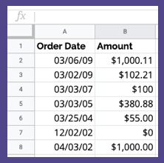
Inconsistent Data
After Cleaning
We decided to have each date be formatted like MM/DD/YY and the currency to be USD. Therefore, we have converted all dates and amounts to reflect this. Additionally, we have ordered the Order Date column to be most recent to least recent. (There was also a null value that we decided to equal $0!)

